Slide 1

HealthGuard
Pro

Slide 2
Health

Slide 3
Health
scores

Slide 4
Health
scores
test

Slide 5
Health
scores
test
leaderboard

Slide 6
Health
scores
test
leaderboard
...

Slide 7
HealthGuard
Pro

Slide 8
HealthGuard
Pro
Your Digital Companion for Wellness and Care

Slide 9

HealthGuard Pro
About Us
HealthGuard Pro is an easy-to-use app that helps you understand and improve your overall health. It looks at your physical health, mental well-being, diet, and lifestyle choices, by using reliable tests and data. The app is designed to be simple and user-friendly, so anyone can use it to take charge of their health.

Slide 10





HealthGuard Pro
Why HealthGuard Pro?
HealthGuard Pro
Comprehensive Insights
Health Monitoring
Team Collaboration
Real-Time Feedback
Get assessments across physical, mental, and nutritional health.
Easily track and manage your overall health status.
Stay connected and
motivated with
scoreboards
Monitor progress
instantly for
improved health
outcomes

Slide 11
HealthGuard Pro
Technology behind
HealthGuard Pro
Design
Backend
Frontend
Figma
UI/UX design tool for wireframing and prototypes
Node.js
for server-side processing
CSS
Styling the web pages
API
api to handle user data securely
JS
Client-side interactivity
Mongo DB Atlas
for Data Storage
React
building dynamic, component-based UI
Axios
handling requests to the backend

Slide 12
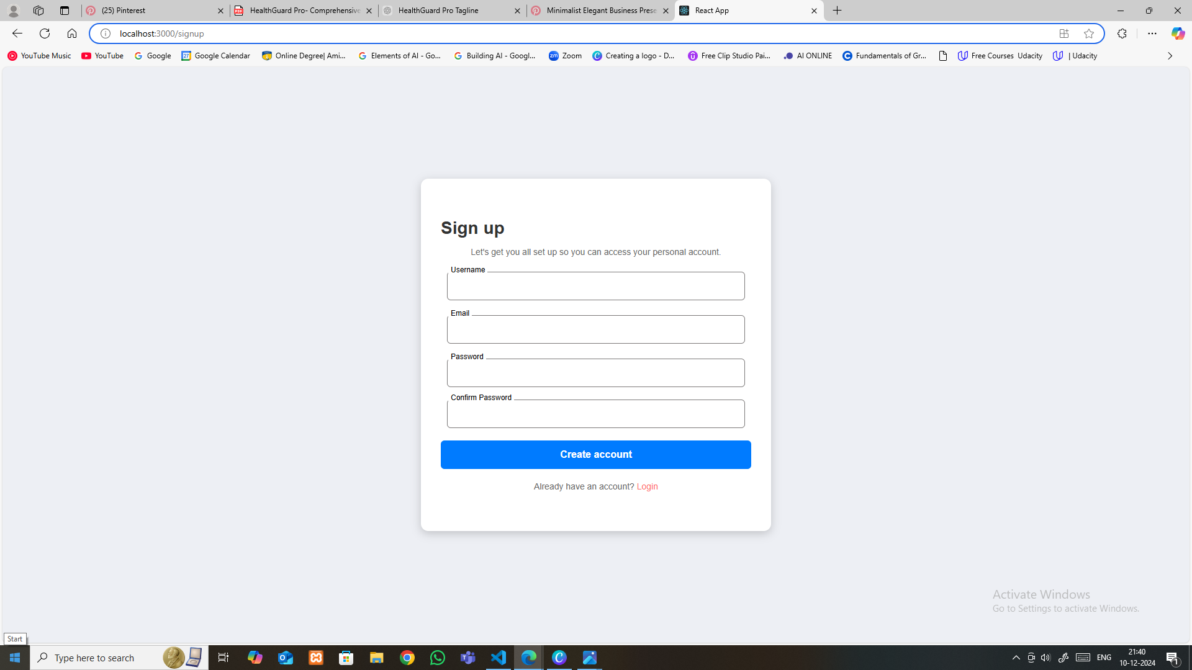

HealthGuard Pro
SignUp
enter username
enter emailId
enter password
confirm password

Slide 13
HealthGuard Pro
SignUp
Designed for ease and accessibility, the Sign-Up page allows new users to quickly create an account. Featuring secure data input fields, user-friendly prompts, and a clean layout, it ensures a smooth start to the platform experience.

Slide 14
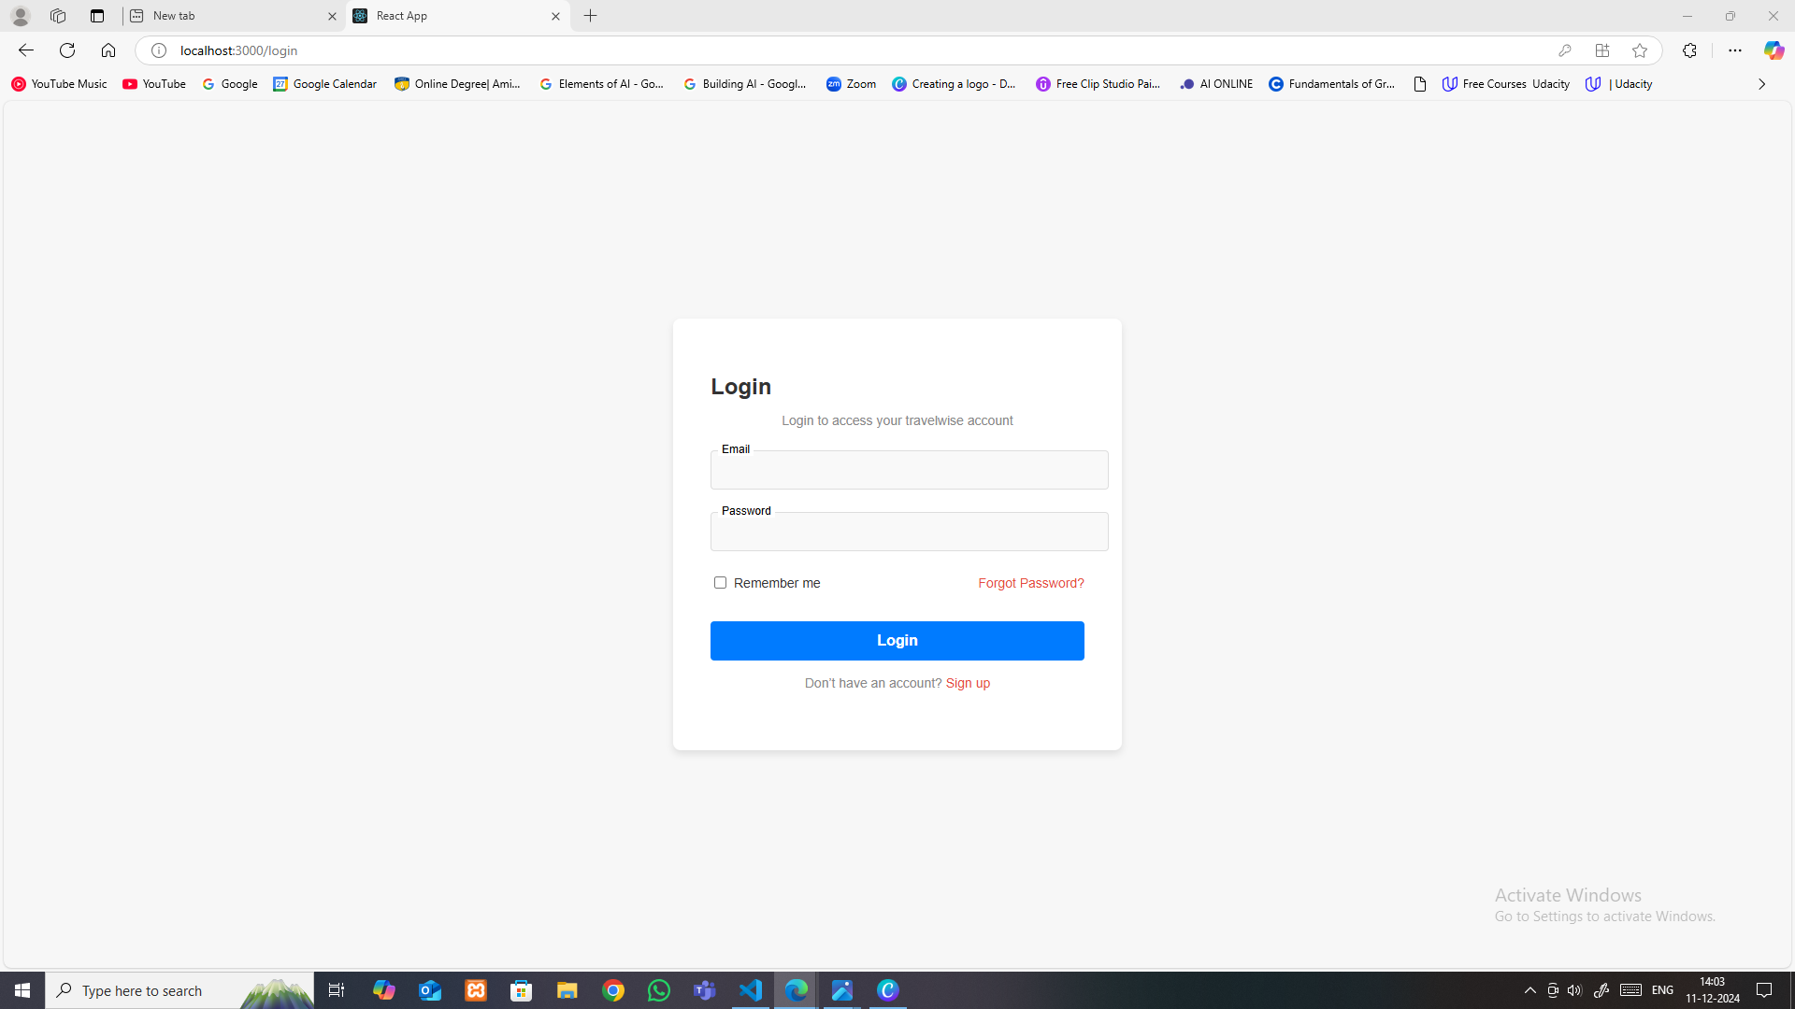
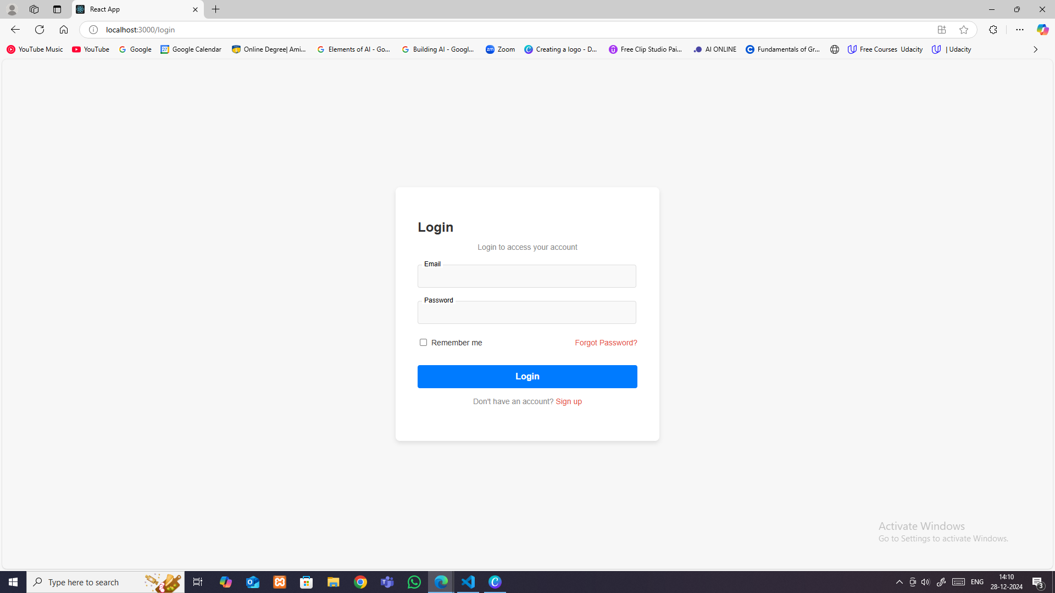


HealthGuard Pro
Login
enter registered email-id
enter password
reset password

Slide 15
HealthGuard Pro
Login
"Effortless Login Experience"
The login page is designed for quick and secure access, featuring easy navigation and user-friendly functionality across all devices.

Slide 16
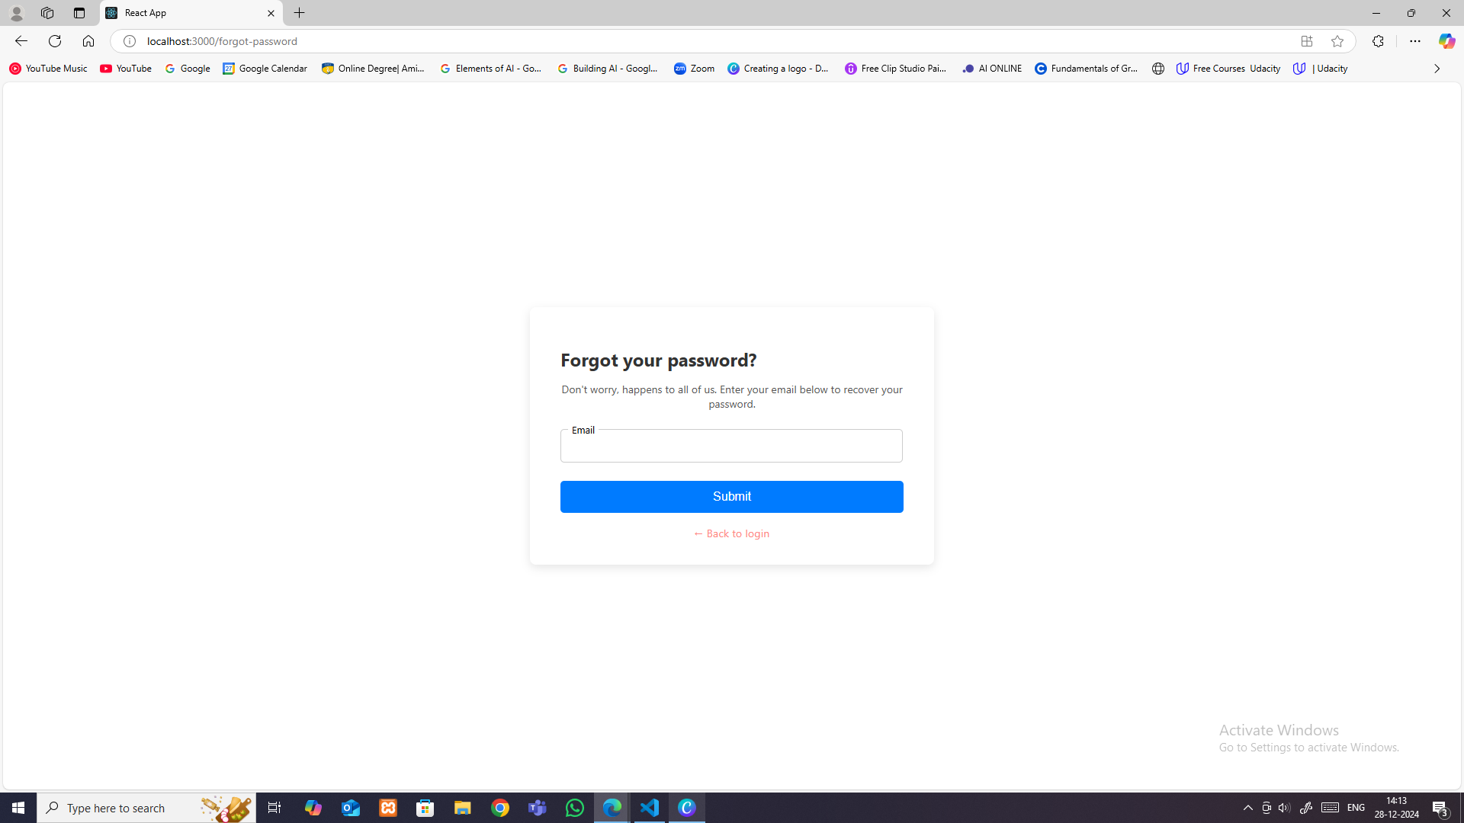
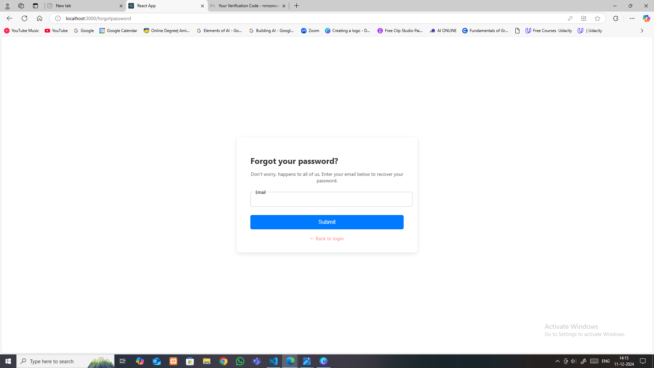

HealthGuard Pro
Forgot password
enter registered email-id
in-case you remember your password

Slide 17
HealthGuard Pro
Forgot password
The Forgot Password page enables users to securely reset their password with ease. By entering their registered email, users receive a verification code to restore account access quickly and safely.

Slide 18
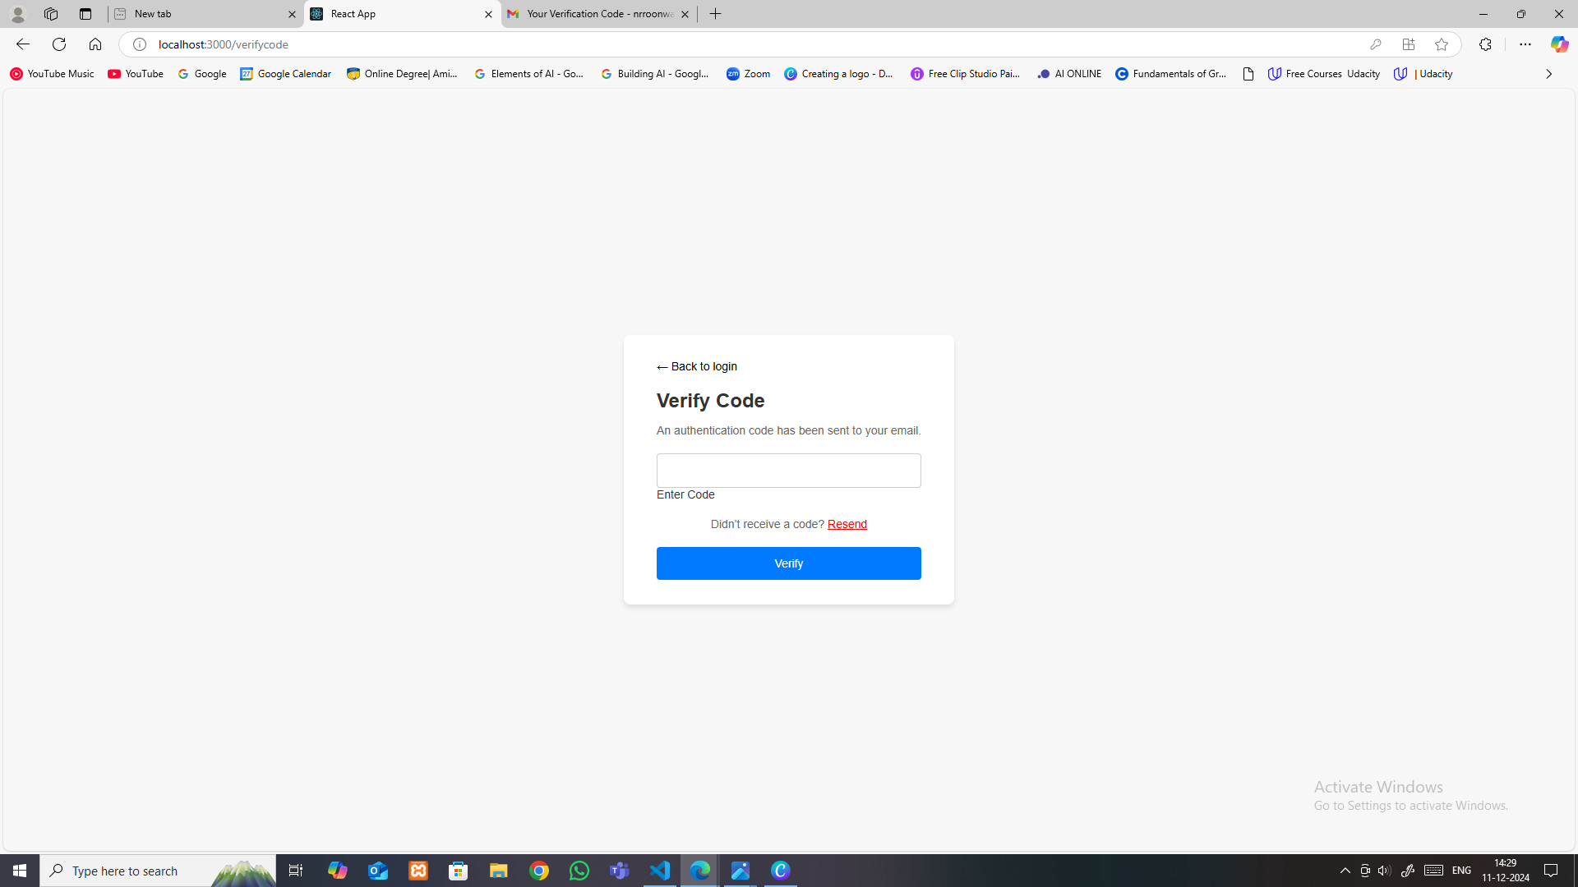
HealthGuard Pro
Verify Code
enter the 6 digit verification code

Slide 19
HealthGuard Pro
Verify Code
The Verify Code page allows users to confirm their identity by entering the code sent to their registered email. This ensures a secure and reliable password recovery process.

Slide 20
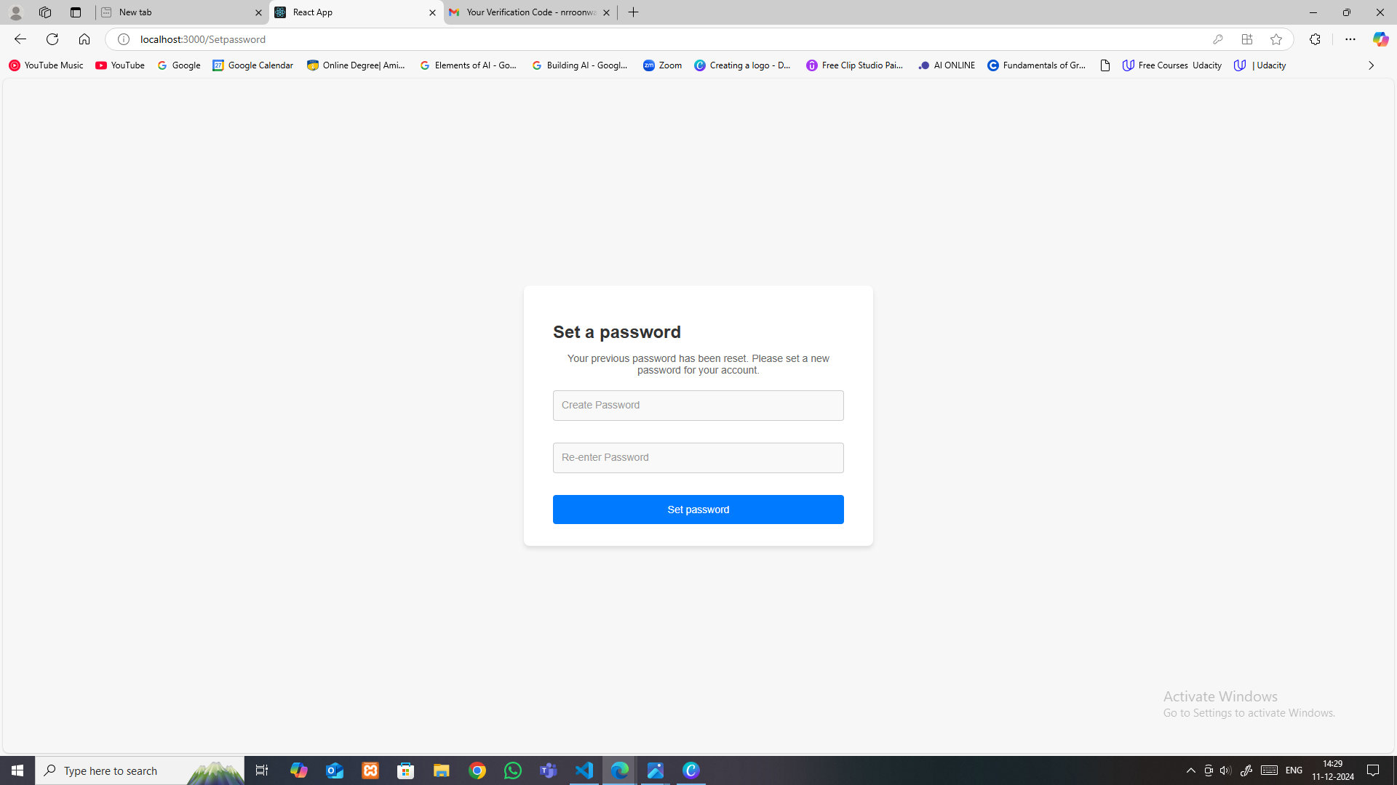
HealthGuard Pro
Reset Password
re-enter to confirm your new password
enter your new password

Slide 21
HealthGuard Pro
Reset Password
The Reset Password page enables users to securely create a new password

Slide 22
HealthGuard Pro
Login
enter registered email-id
enter password

Slide 23
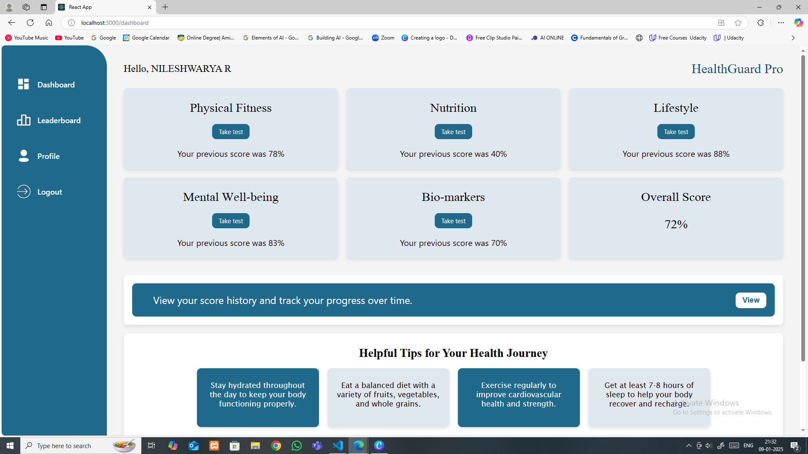
HealthGuard Pro
Dashboard

Slide 24
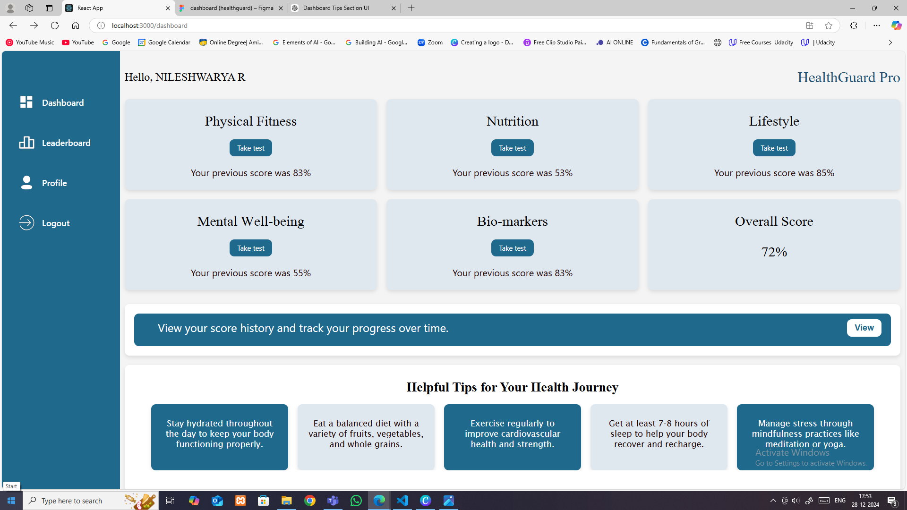


HealthGuard Pro
Dashboard
The "Take Test" section allows users to evaluate their health in various dimensions, providing actionable insights to achieve fitness and wellness goals.

Slide 25
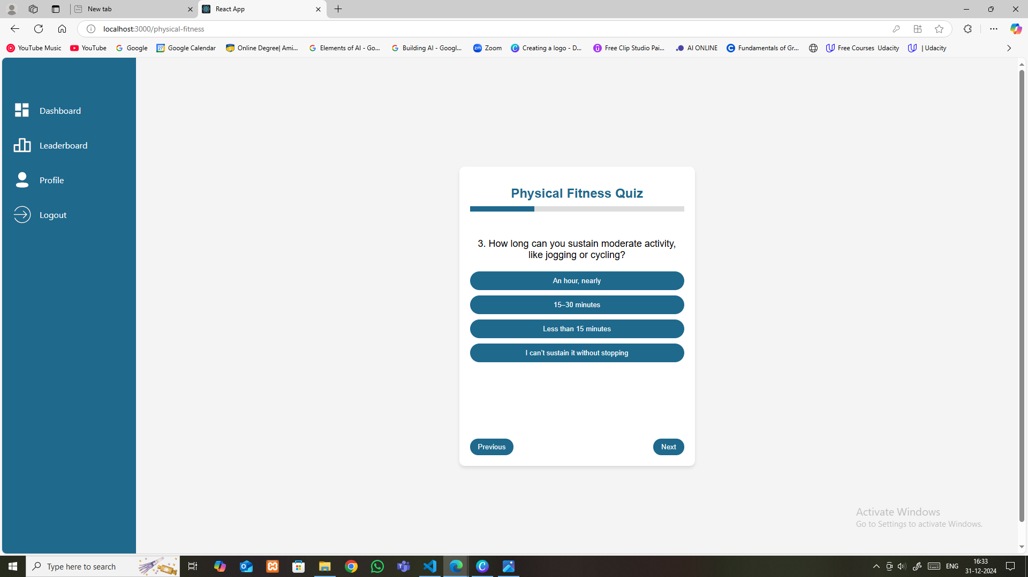
HealthGuard Pro
Quiz
Progress bar that visually tracks completion
clean and user-friendly
interface

Slide 26
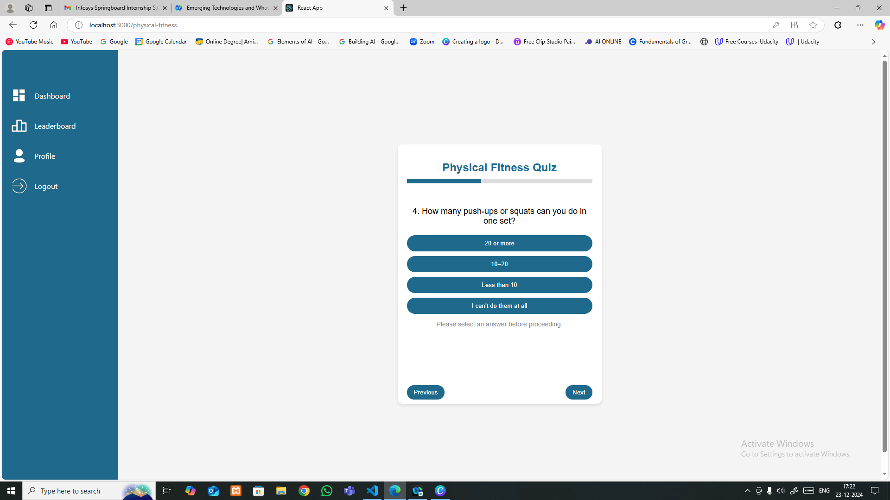
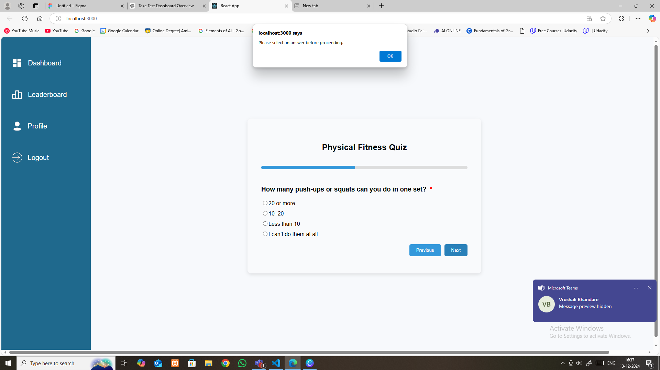
HealthGuard Pro
Quiz
If a user tries to proceed without selecting an option, a prompt appears with the message: 'Please select an answer before proceeding.' This ensures that all questions are answered before moving forward, maintaining the integrity of the quiz.

Slide 27

HealthGuard Pro
Dashboard
The 'View’ button enables users to check their quiz results instantly. Once clicked, it displays the scores of each section, giving users a clear overview of their performance."

Slide 28
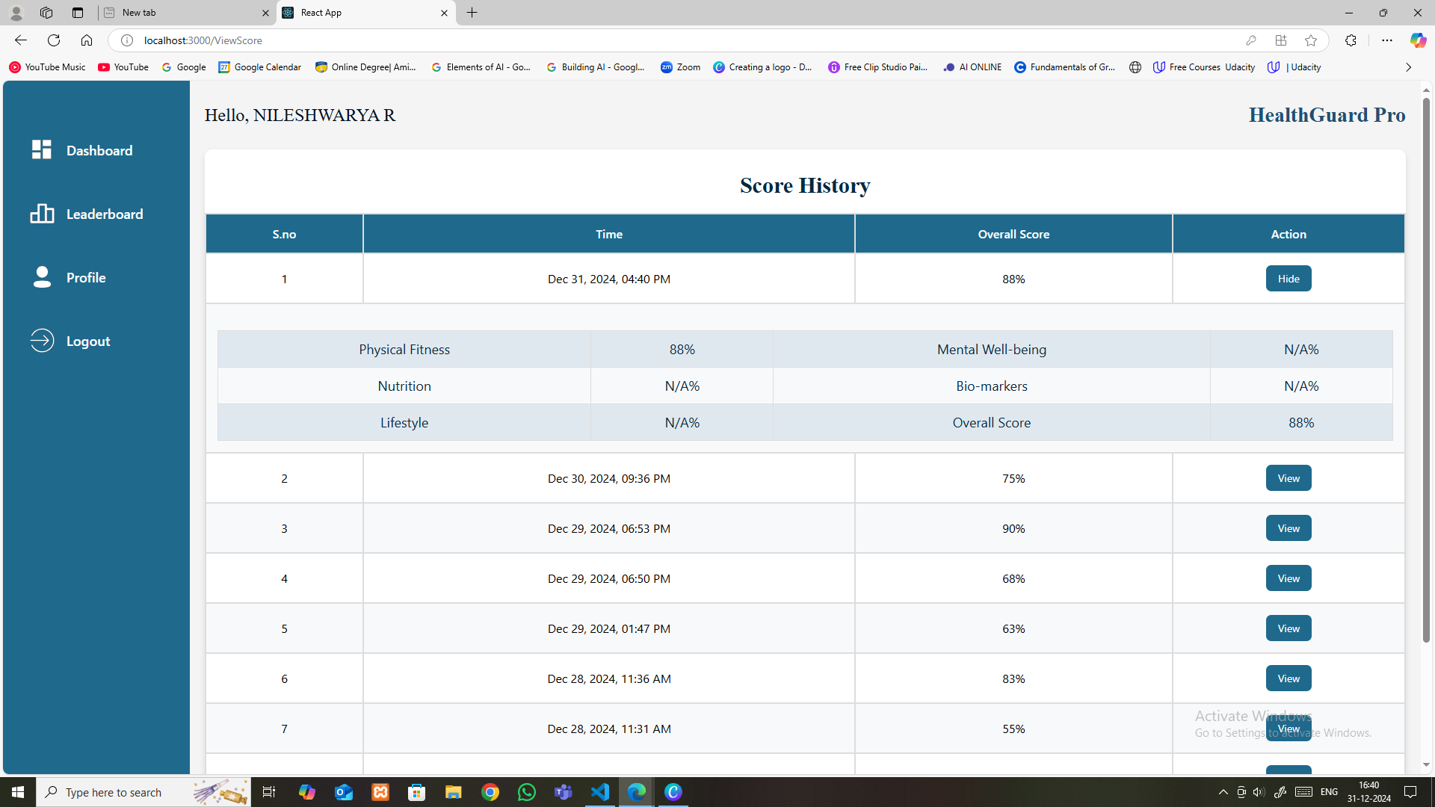
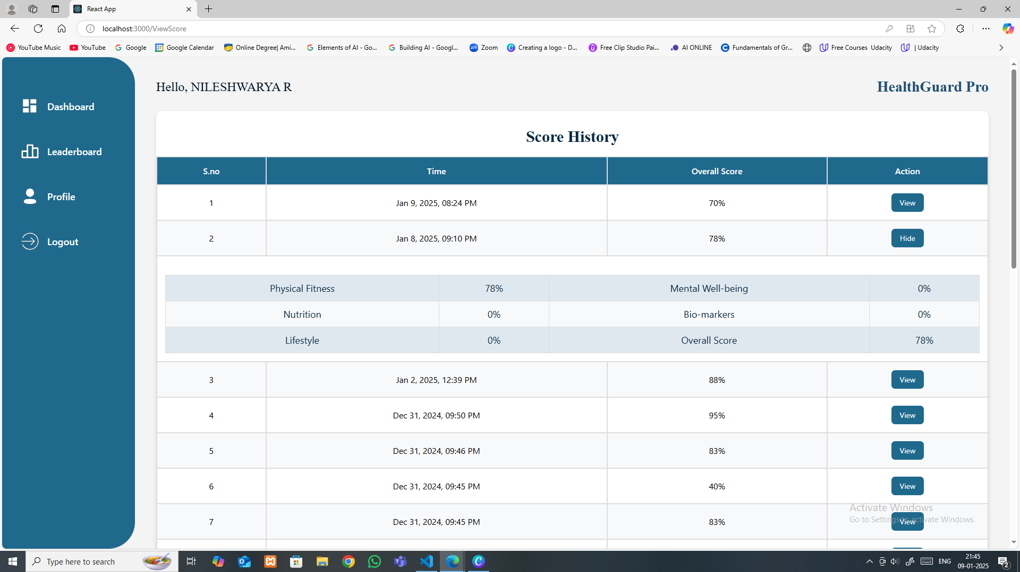
HealthGuard Pro
View score

Slide 29
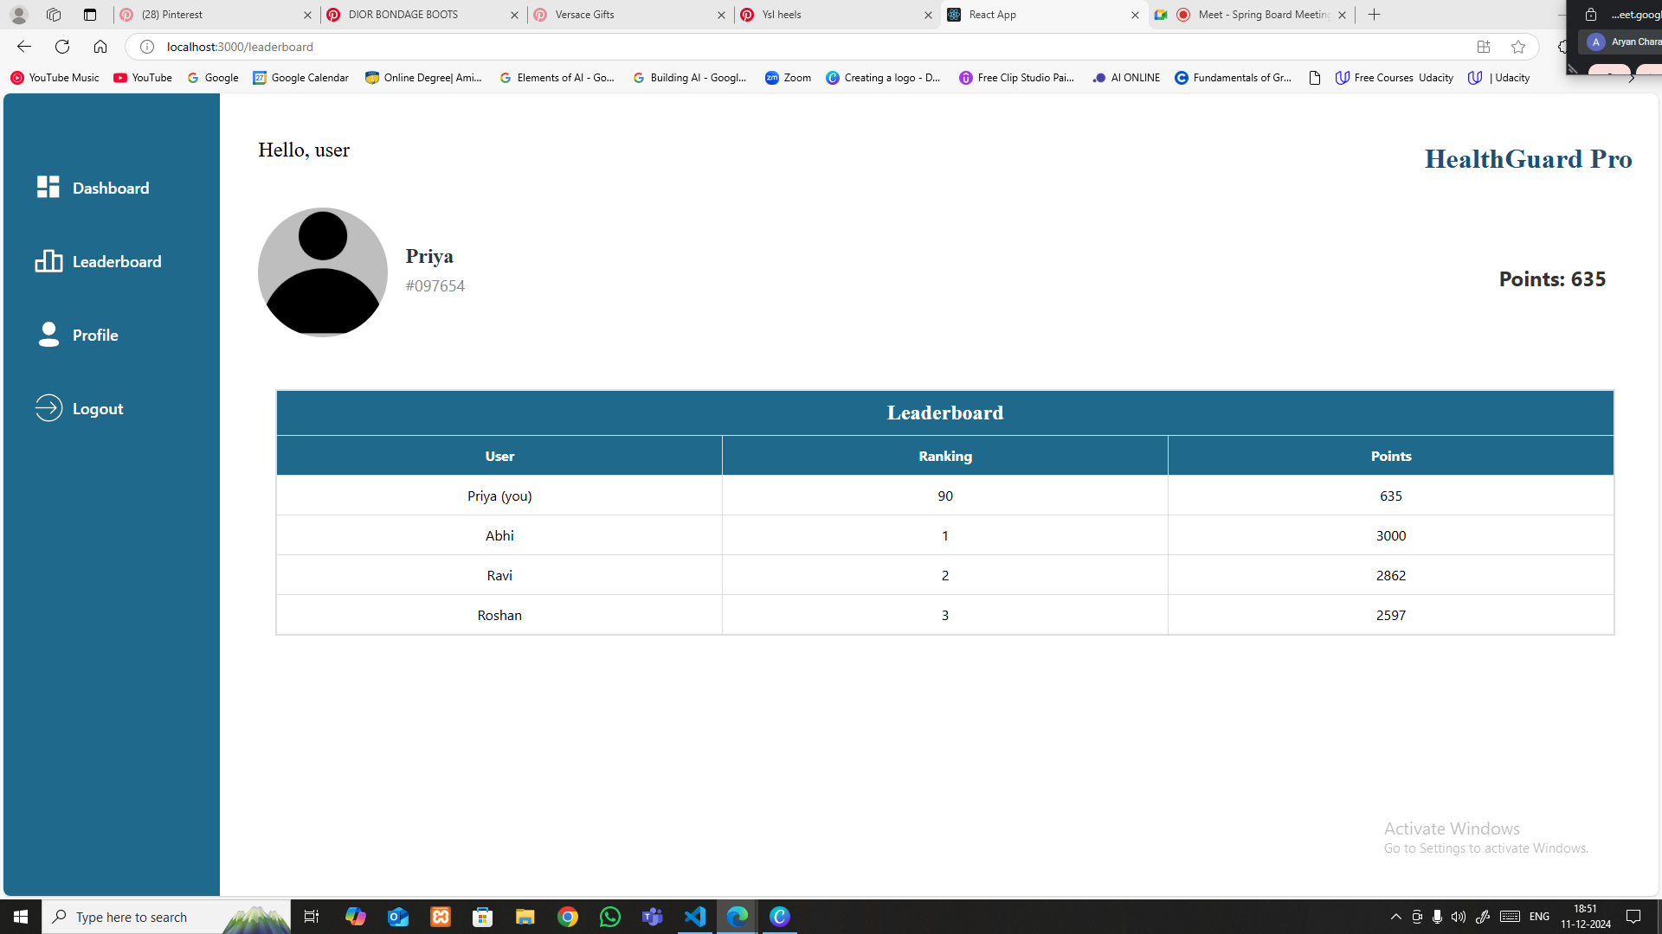
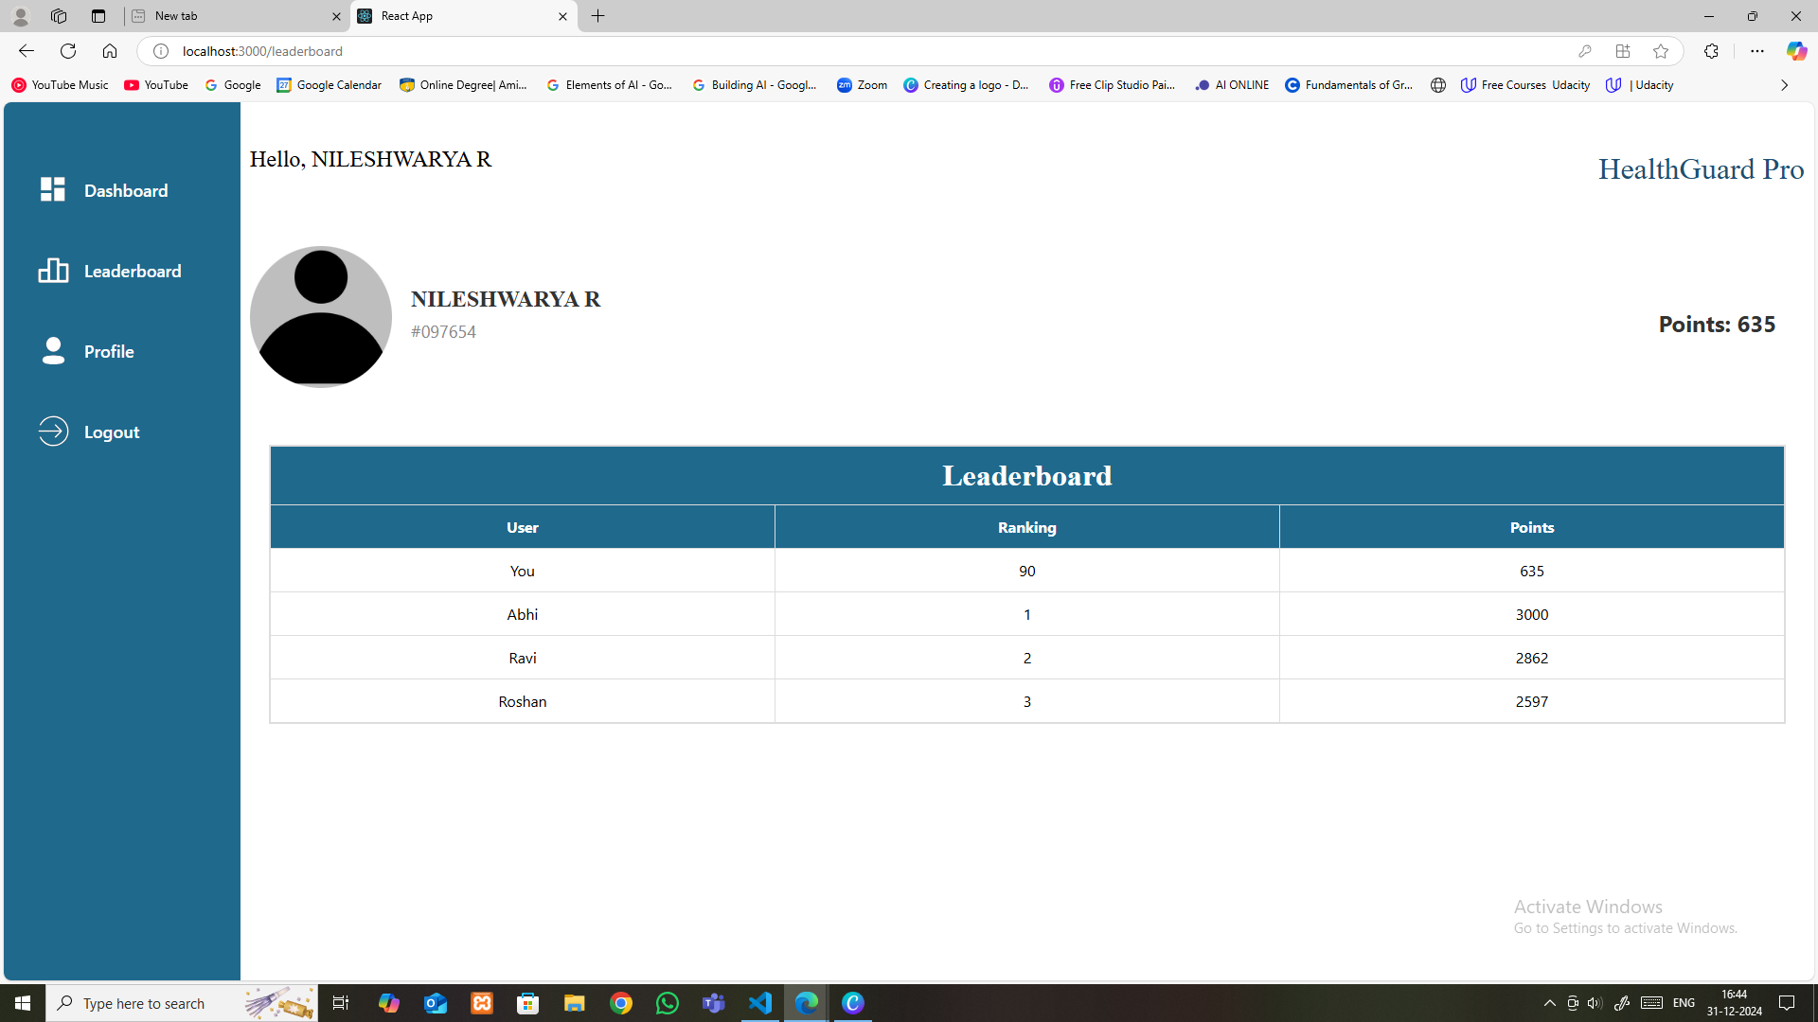
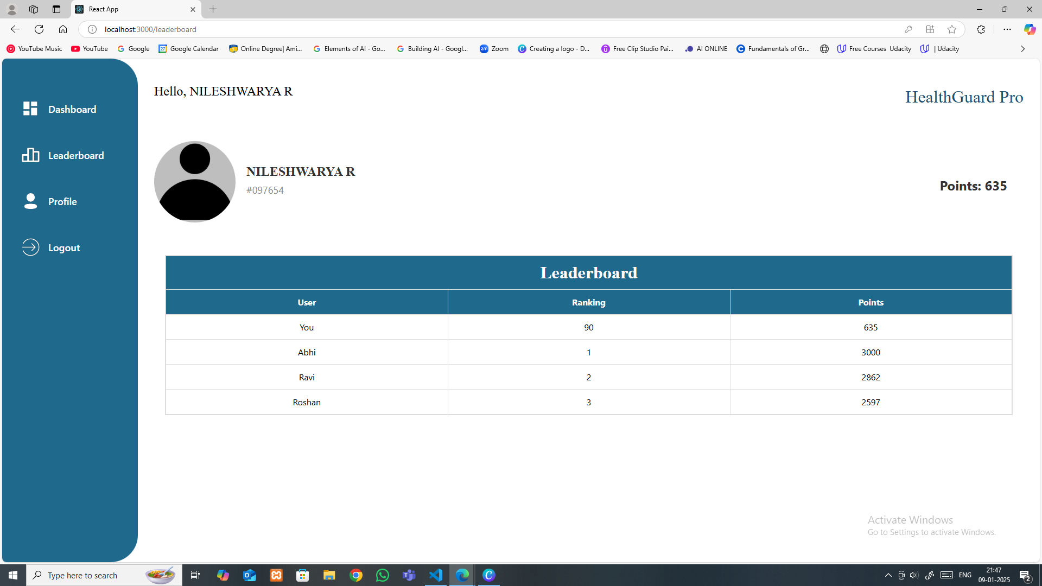
HealthGuard Pro
Leaderboard

Slide 30
HealthGuard Pro
Leaderboard

Slide 31
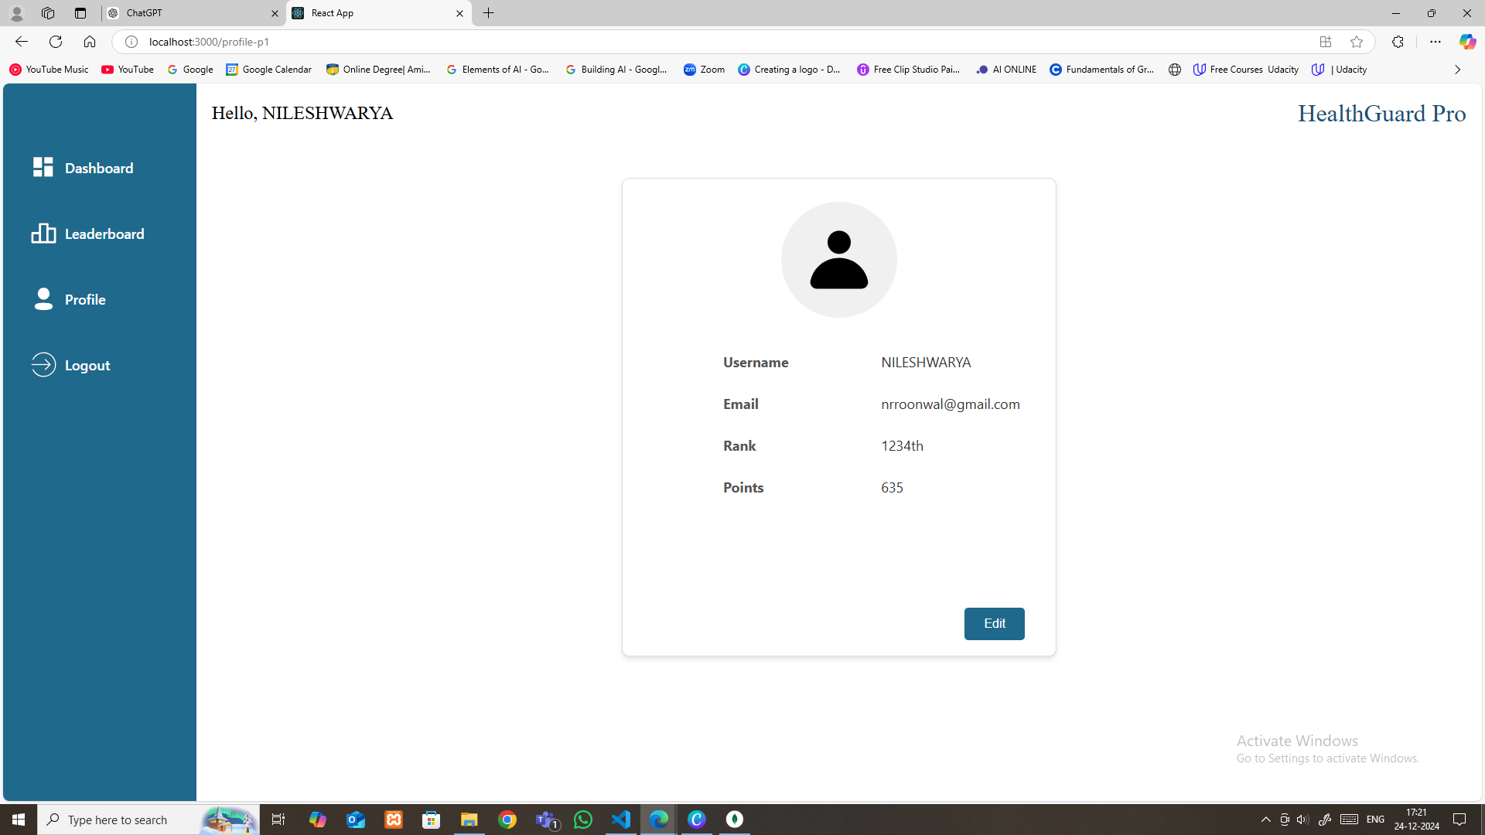
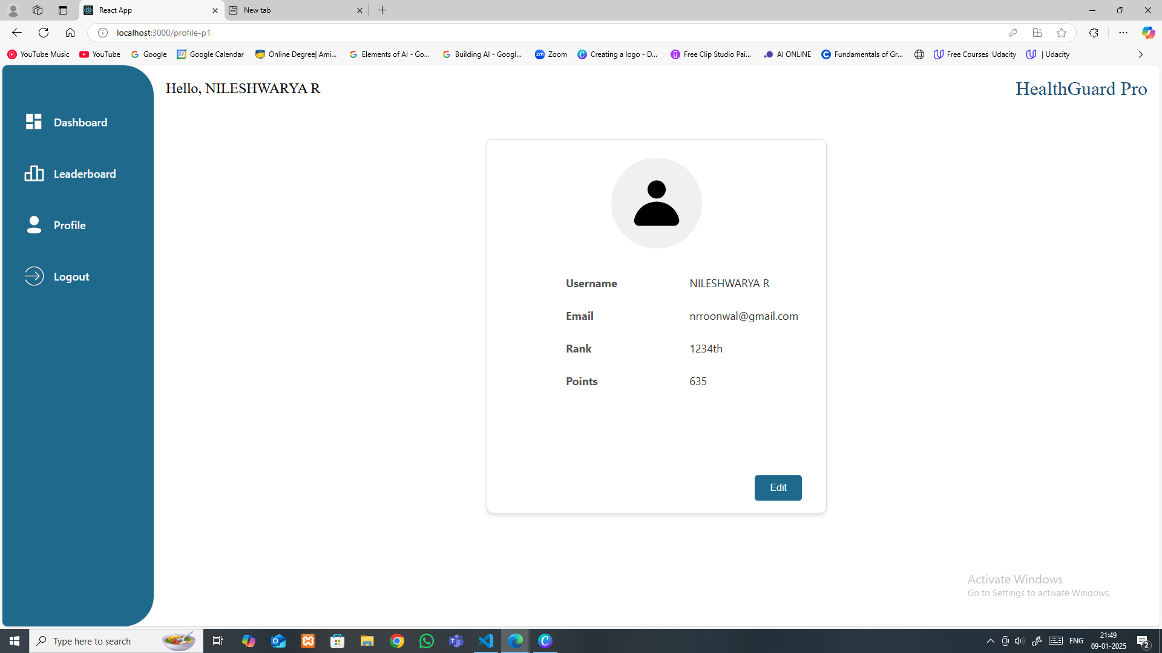
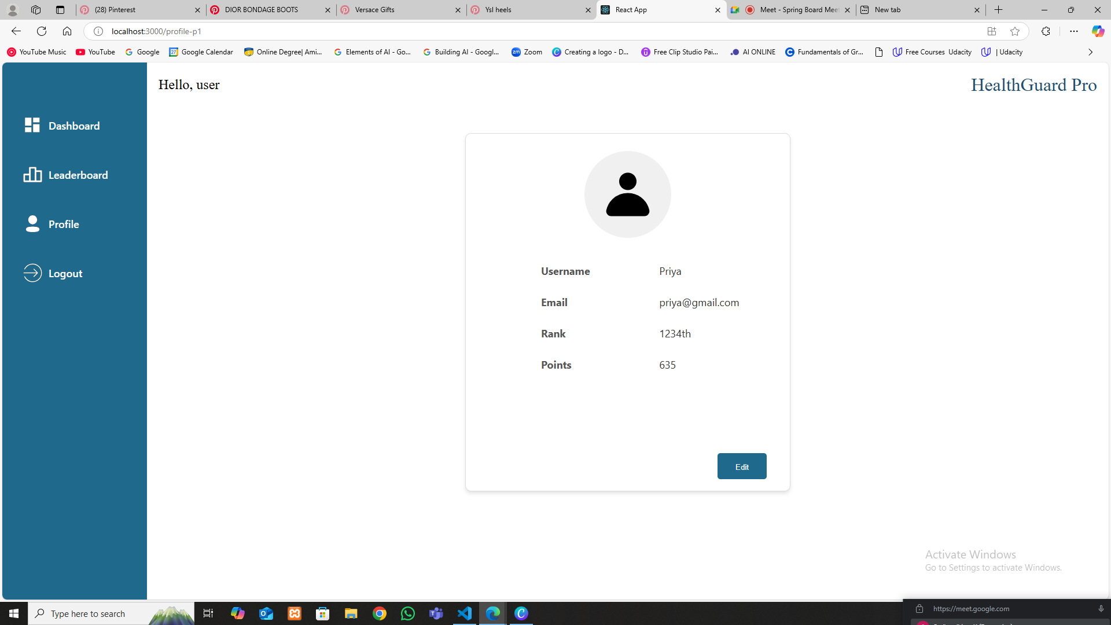
HealthGuard Pro
Profile

Slide 32
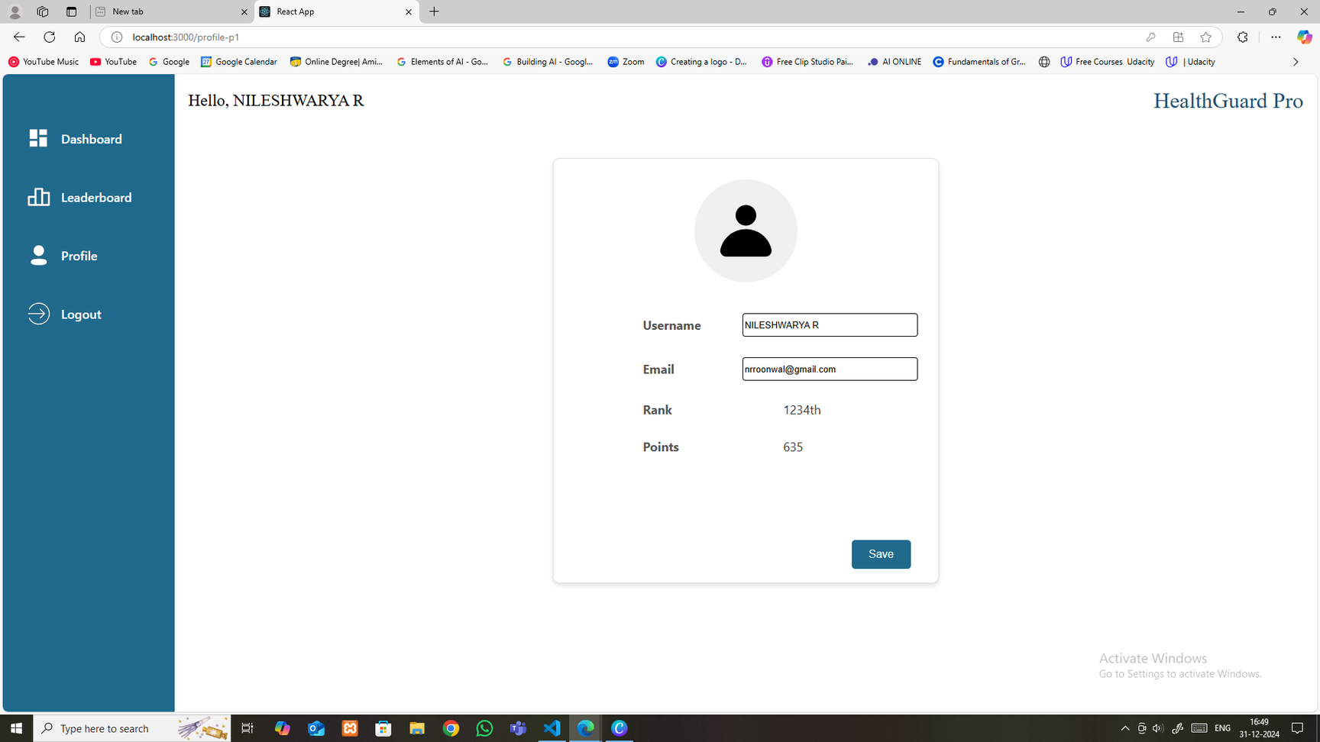

HealthGuard Pro
Profile

Slide 33
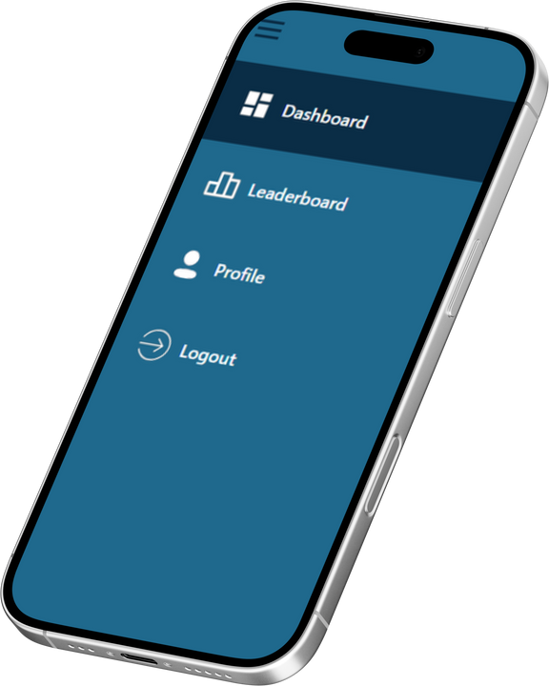
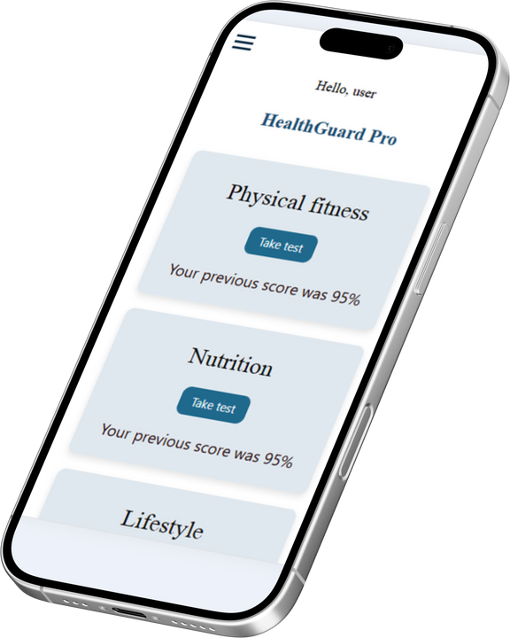
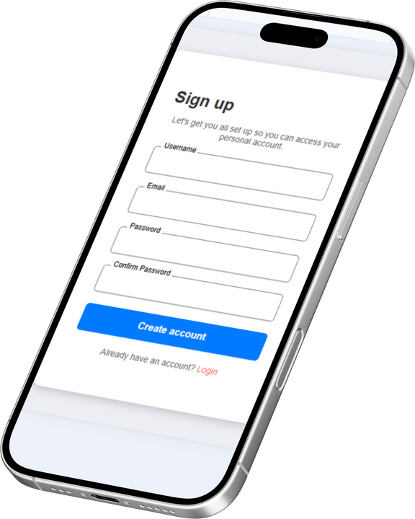
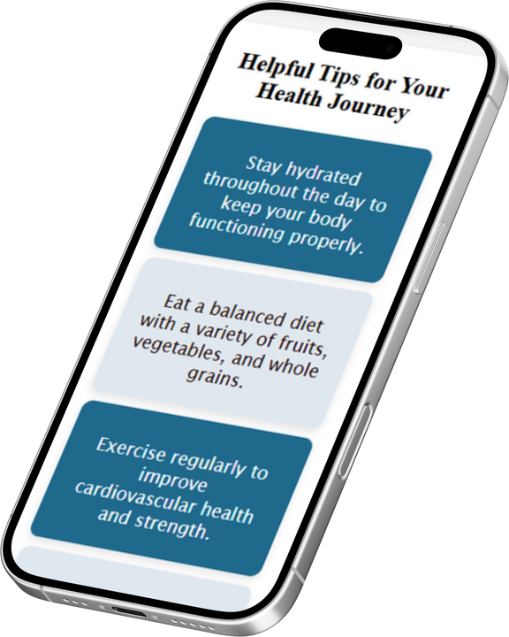
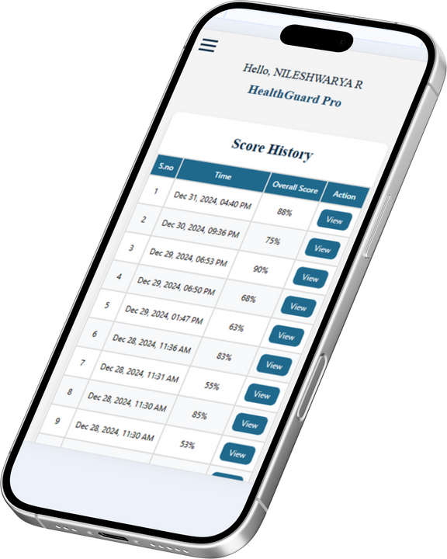
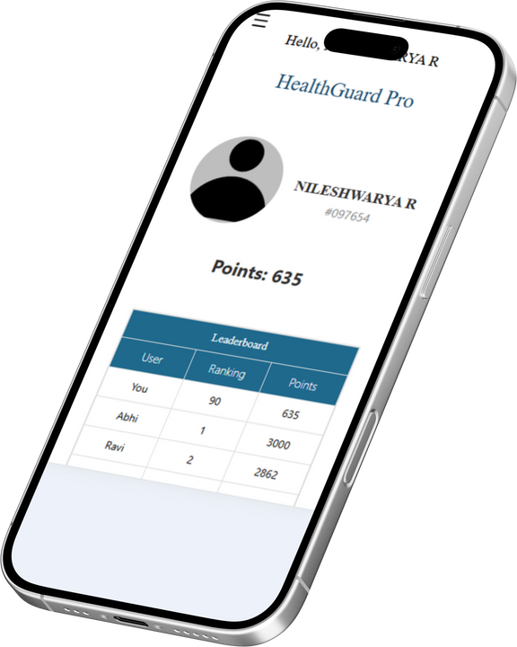
HealthGuard Pro
Responsiveness
Seamless Across
All Screens
Experience effortless usability with a design that adapts perfectly to mobile, tablet, and desktop devices. Enjoy consistent functionality anywhere, anytime.

Slide 34

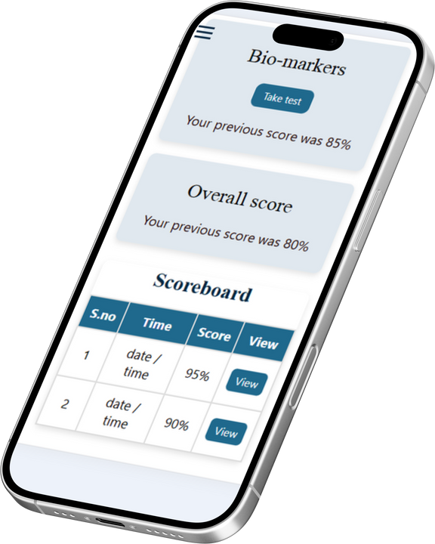
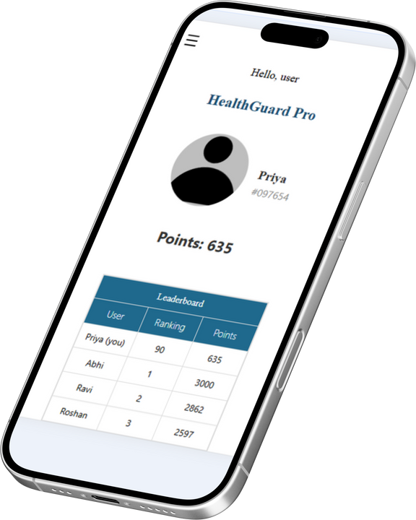
HealthGuard Pro
Responsiveness
The responsive design ensures that the platform adapts smoothly to different screen sizes, providing an optimal user experience across desktops, tablets, and mobile devices.

Slide 35
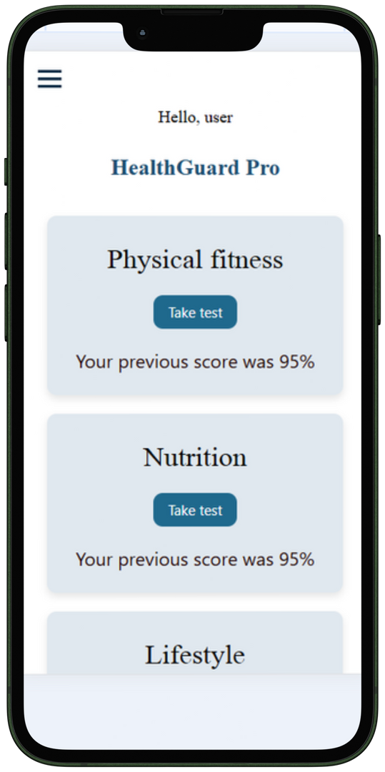
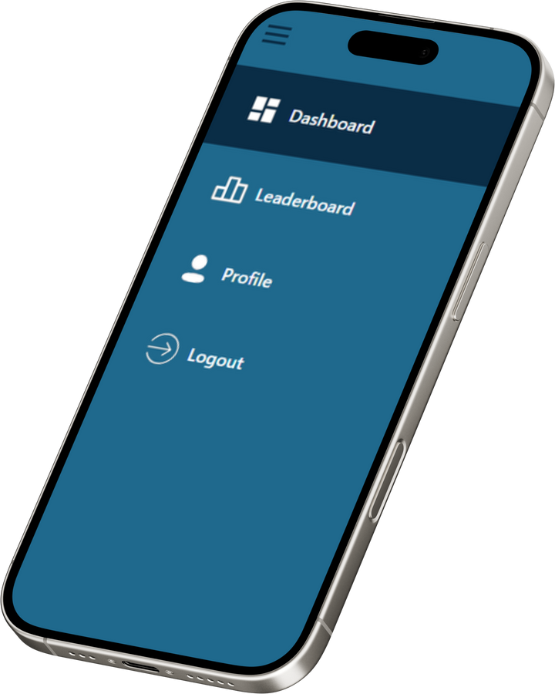
HealthGuard Pro
Responsiveness
HealthGuard Pro, Built for Every Screen

Slide 36
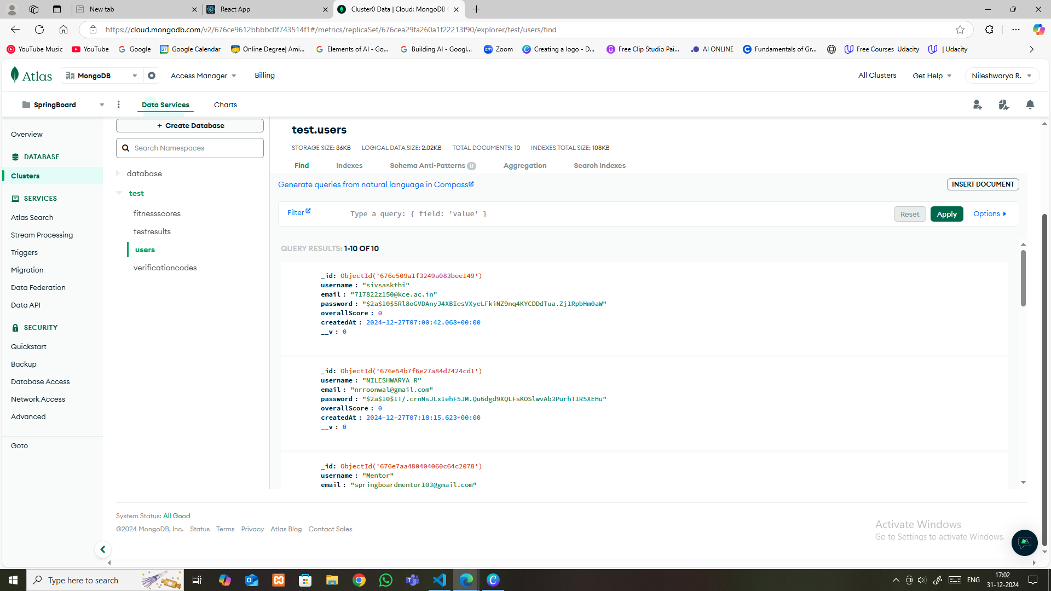
HealthGuard Pro
Backend

Slide 37
HealthGuard Pro
Our Team
Mahesh
Nileshwarya R Roonwal
R Niranjana
Siva
Vrushali Bhandare

